Slide 1


Node js LectuRe 4
National Telecommunication Institute
Ministry of Communications and Information Technology

Slide 2
Agenda
Mongoose
-Middlewares (ex: saving passwords)
Hashing VS Encryption
bcryptjs
JWT
Authentication vs Authorization

Slide 3
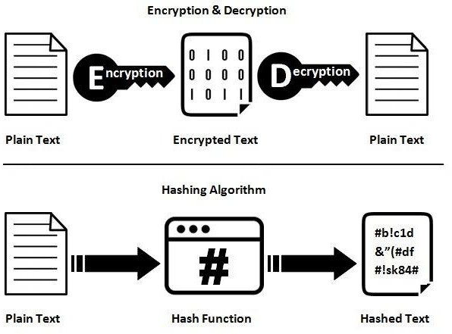
Hashing vs EncRyption
encryption is a two-way function that includes encryption and decryption while hashing is a
one-way function that changes a plain text to a unique digest that is irreversible.

Slide 4
BcRypt Js
The bcrypt npm package is one of the most used packages to work passwords in JavaScript.
with
you never store a password in plain text in the database or in place.
any other
you generate a hash from the password, and you store that. var bcrypt = require('bcryptjs');
var salt = bcrypt.genSaltSync(10);
var hash = bcrypt.hashSync("B4c0/\/", salt);

Slide 5
BcRypt Js
Given the same password and a hash it’s possible to find out if the hash was built from that password, using the
bcrypt.compare()function:
bcrypt.compare("B4c0/\/", hash, function(err, res) {
// res === true
});

Slide 6
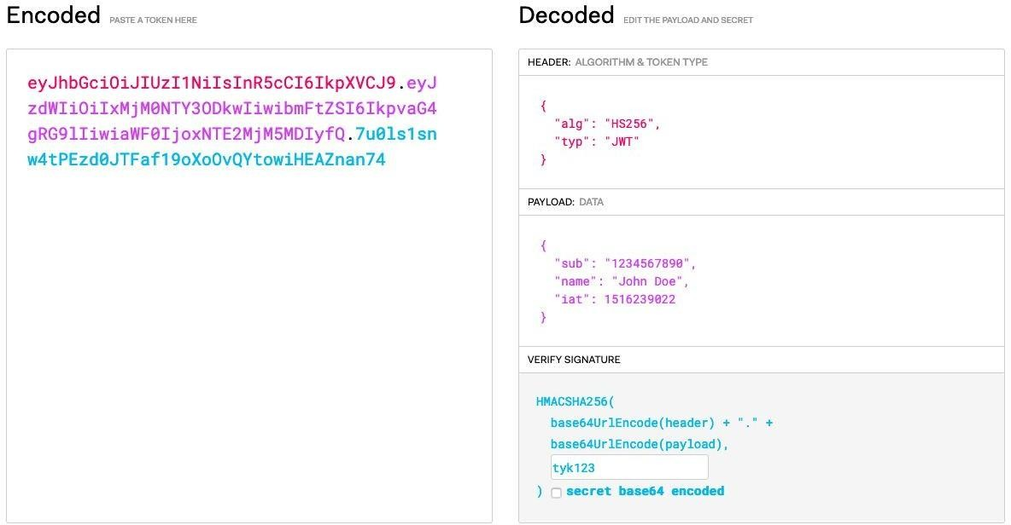
JWT

Slide 7
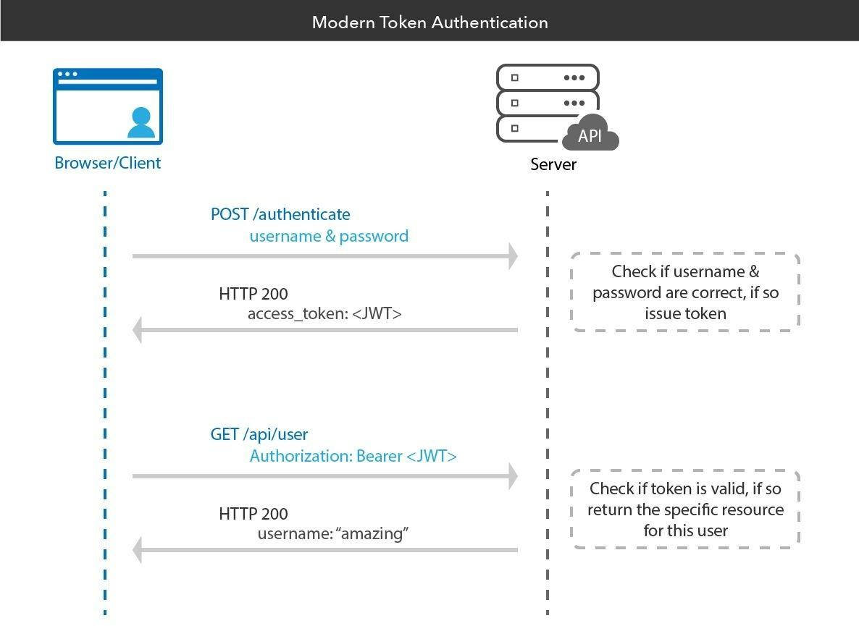
JWT

Slide 8
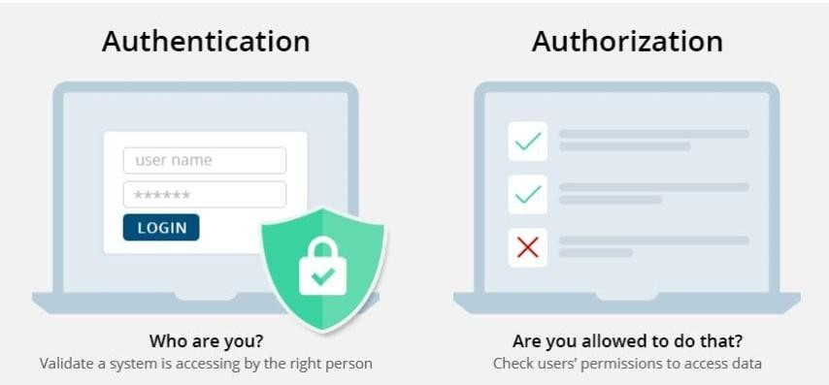
Authentication vs AuthoRization
authentication is the process of verifying who someone
authorization is the process of verifying what specific applications, files, and data a user has access to

Slide 9
Thank you

